Slide 1
University of Michigan – Dearborn ECE 574: Advanced Software Methods for Engineering Applications. Fall 2022 Low-Cost Hardware in the Loop (HIL) Test Tool
Final Project Presentation
Presented by:
Luis Castaneda-Trejo

Slide 2
Topics
Commercial Off The Shelf (COTS) Technology
Project System Components.
System Dataflow.
System Architecture.
System Process Development Model.
Project Picture.
Summary.

Slide 3
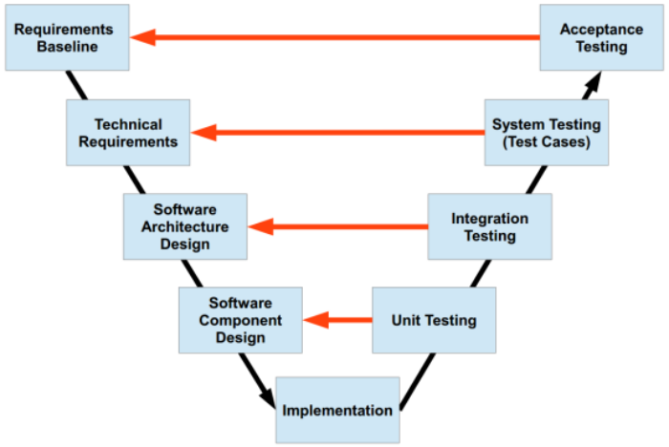
Introduction
Validation and Verification (V&V) teams rely on automated testing to improve quality on Software and Systems testing.
Some companies spend 50% or more on testing activities to ensure product quality.
Commercial Off The Shelf (COTS) Technology provides great tools for V&V teams to standardize automation frameworks and test methodologies.
Some of these tools have great benefits but are very costly and sometimes unaffordable, these tools often require both development and runtime licenses.
In V&V, majority use of COTS technology is used here.
Source: MathWorks V-Model
www.mathworks.com/help/rtw/gs/v-model-for-system-development.html

Slide 4
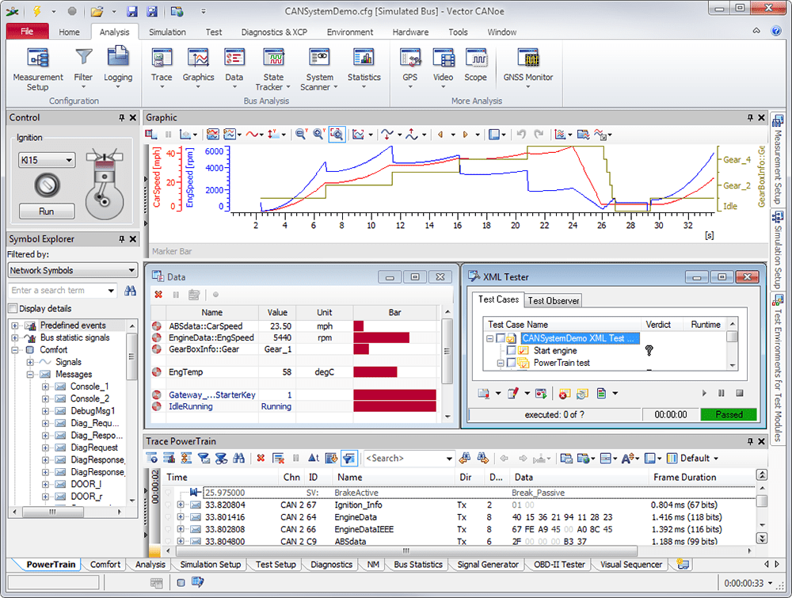
I. Commercial Off The Shelf (COTS) Technology
Some examples of common COTS technology tools in the Automotive Industry.
Vector Informatik (Vector)
- CANoe/CANalyzer
- CANape
Intrepid Control Systems (ICS)
- Vehicle SPY
National Instruments (NI)
- LabVIEW
- TestStand
Costly Licenses!
Sometimes not needed after development is done.
CANalyzer. Source: Vector Informatik

Slide 5
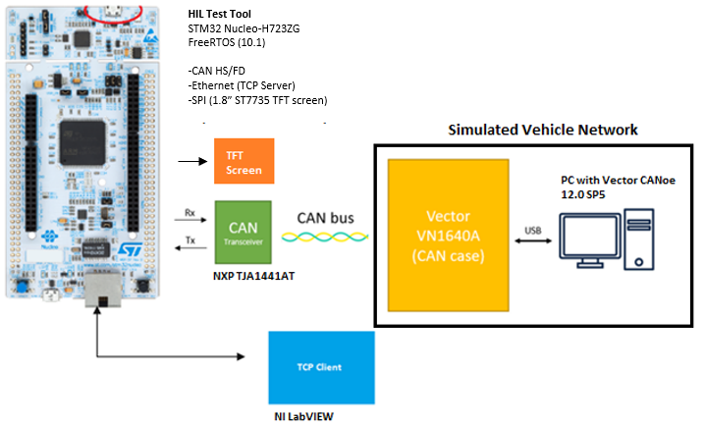
II. Project System Components
This can be a single ECU or a complete simulated network.
Arm Cortex M7
Can work with any tool that can send TCP commands.

Slide 6
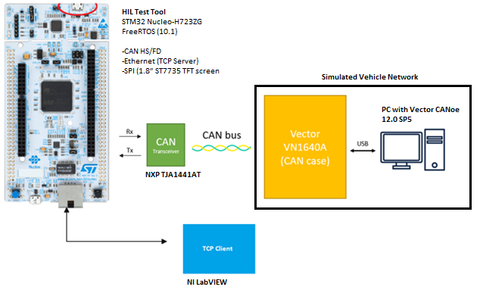
III. Overview of System Dataflow
Message Process
CAN Message(s)
CAN Message(s)
Test Results
Test Mode Select

Slide 7
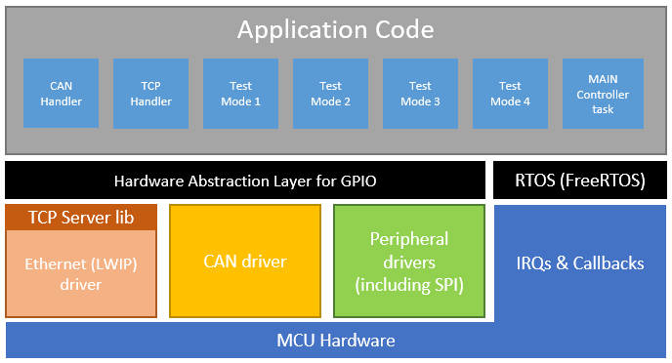
IV. System Architecture
- Portable architecture to other MCUs running FreeRTOS.
- Modular architecture with same State Machine pattern for test modes.
- Additional features and task control can be added to the MAIN Controller task.
- Leverage use of STM’s Hardware Abstraction Layer for I/O.

Slide 8
V. System Process Development Model
The project used the Waterfall Process Development Model.
This academic project did not involve discussions with customers or stakeholders; therefore, requirements were defined at project proposal stage.
Hardware and Software design were developed after the requirements stage and no additional features were added.
All components were integrated and tested using the 4 test modes described in the report.
Software optimizations were done after functionality was verified.
Requirements Definition
HW and SW design
Integration and Testing
Operation and Maintenance

Slide 9
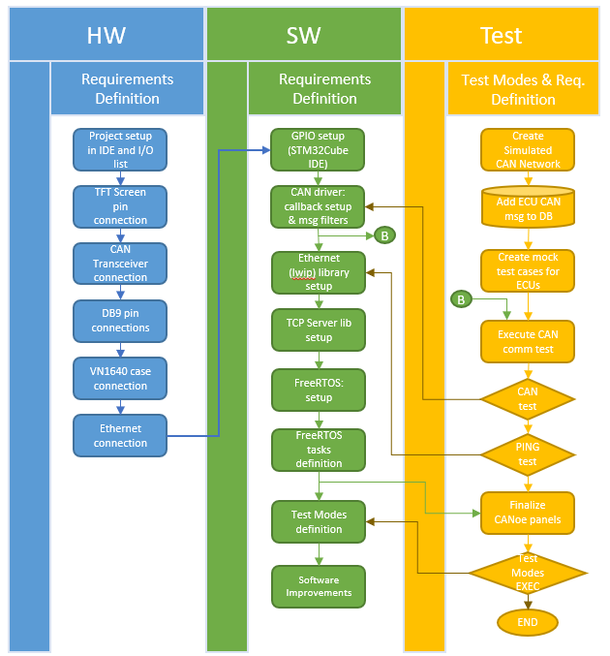
V. System Process Development Model (cont.)
Project was divided in 3 areas: Hardware, Software and Test.
Each area has its own set of requirements. Section III in the Project Report.
Hardware integration was done in a sequential way.
Software and Test went back and forth specially with the CAN and Ethernet tests.

Slide 10
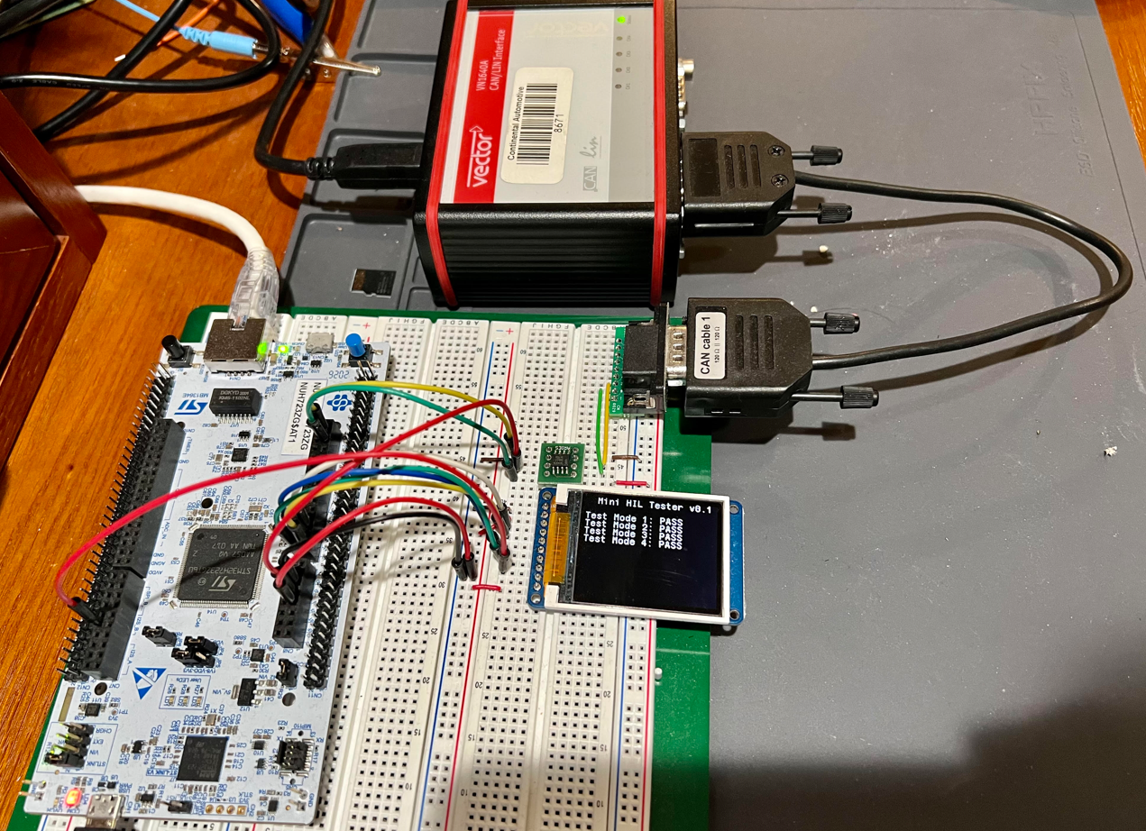
VI. Project Picture

Slide 11
VII. Summary
- COTS technology offers great advantages and tools for Validation and Verification (V&V) teams for System Testing.
- Companies spend thousands of USD in validation and verification stages and each year teams are encouraged to do more with less without sacrificing quality.
- The proposed Low-Cost HIL Test Tool could be a good tool, basic test framework and good alternative for small applications that need to be tested fast and efficiently.
- The tool could be used by engineering teams and technicians without the cost of development or runtime licenses once the test messages/modes to the Device Under Test (DUT) are known.
- Although the STM32 platform offers great flexibility, C programming language is not the 1st choice for test developers and perhaps a different platform with Python support would be better (i.e., Raspberry Pi).
- The System Development Process Model would have to change to Spiral, V-Model or custom one if this project would have to be presented to stakeholders to allow prototypes and continuous integration and development.

